Slide 1
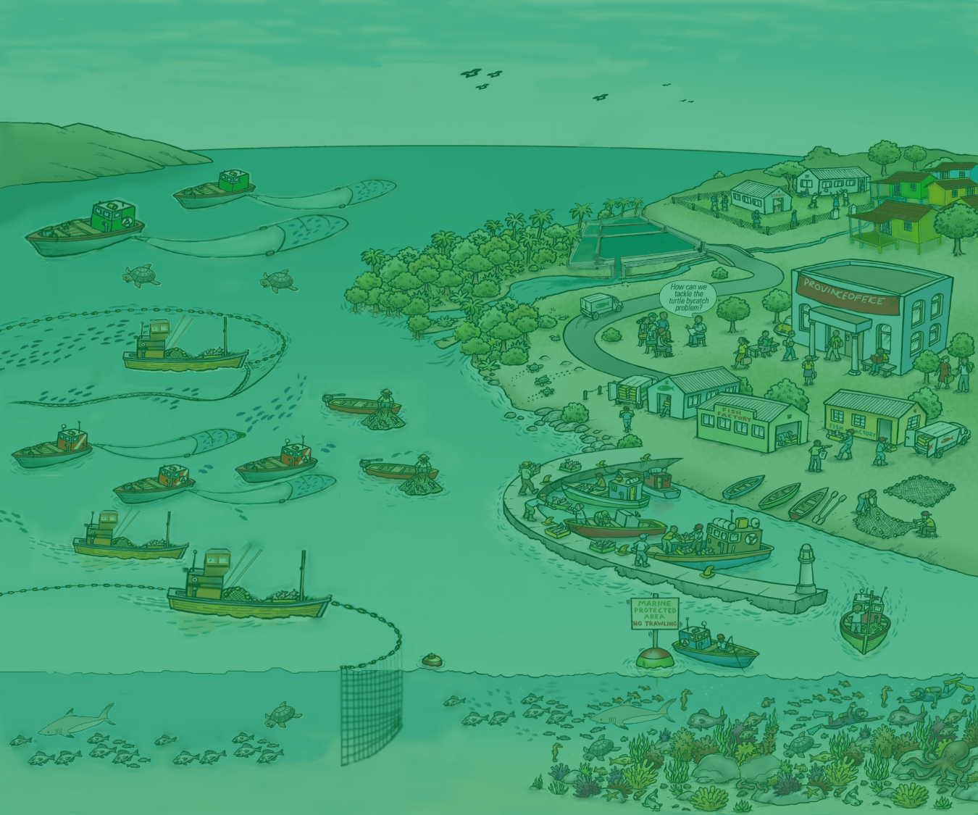

2. Issues and Threats, Fisheries Management and the Ecosystem Approach
Version 1

Slide 2

Coastal marine ecosystems
Focus for this course…
Note: Ecosystem approach can be applied to any other system e.g. inland and offshore ecosystems or aquaculture systems
2
Notes:
You are now going to do the threats and issues activity. Show this slide to focus this course on Marine coastal ecosystems in Asia: (this is to set the context, ensure we are all on same footing). Could be changed to inland waters, etc. as the principles are the same.

Slide 3
Issues and threats
Fisheries and aquatic environment are severely degraded
Livelihoods and economy are threatened
Many issues are inter-linked and require holistic
solutions
Many issues are the result of human activities – people are central to solutions
3
Notes:
You are now going to do the threats and issues activity. Show this slide to focus this course on Marine coastal ecosystems in Asia: (this is to set the context, ensure we are all on same footing). Could be changed to inland waters, etc. as the principles are the same.

Slide 4
Discuss threats and issues relating to your fisheries and the associated ecosystem
Group activity
Write each issue/threat on a SEPARATE card, think of as many as you can
Place the cards on the flipchart
4. Sort the threats and issues identified earlier into:
Those that can be addressed by existing fisheries management
Those that can addressed through collaboration with other ministries
Others
4
Notes:
This is the 1st of many group activities throughout the course. For now, use random groups. Aim of activity is (i) to come up with relevant issues and threats which participants will work with after lunch and later on in course, and (ii) as an icebreaker, so participants get talking to each other and get to know a smaller group of other participants in more depth.
Definitions:
Threat= A danger/ a problem
Issue = something that impacts on your fishery
A lack of something in place can also be an issue.

Slide 5
Management
The many threats and issues identified require management to:
minimize their impact and
improve the benefits to society
Fisheries management: “An integrated process that aims to improve the benefits that society receives from harvesting fish.”
Adapted from FAO
5
Notes:
The many threats and issues identified in Session 1 require management to
(i) minimize their impact and (ii) improve the benefits to society. One definition is “An integrated process that aims to improve the benefits that society receives from harvesting fish”.
Background info
This definition of management is adapted from FAO. It stresses the integrated nature of a number of activities, including (i) data and information gathering, (ii) analysis, (iii) planning, (iv) decision making, (v) allocation of resources and (vi) enforcement and compliance.

Slide 6
Activity
Can all of the threats and issues identified be addressed through fisheries management?
If not, what is needed to address them?
6
Notes:
Instruction: The group to discuss what they understand about fisheries management that exists in their countries.
Have participants categorize their previously identified threats and issues into 2 categories – those that can be addressed by existing fisheries management and those that can not (e.g. tick the ones that can).
The purpose is to illustrate that many of the threats and issues are not fisheries-specific but broader to the wider ecosystem (which is why we need EA- see next slide).

Slide 7
Considerations about existing
fisheries management
Fishery resources are seriously degraded in the country with many issues
Existing fisheries management does not cover all threats and issues and can often fail
A broader and more inclusive approach is needed that expands on existing management
7
Notes:
Based on their activity, discuss that existing fisheries management, due to its fisheries specific focus, is not capable of addressing many of the threats and issues facing the fisheries. The purpose is to illustrate that many of the threats and issues are not fisheries specific but broader to the wider ecosystem and that we need a broader approach.

Slide 8
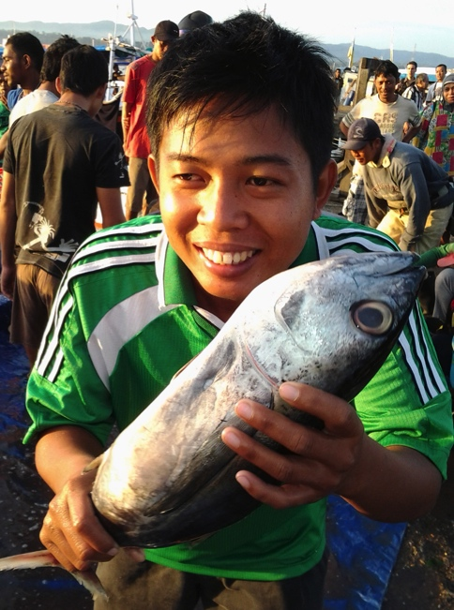
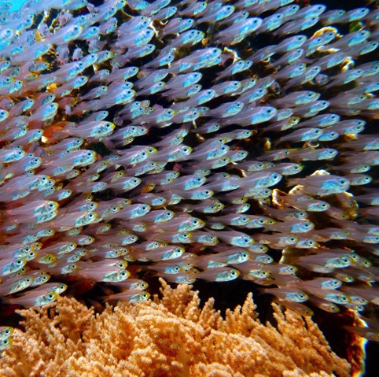
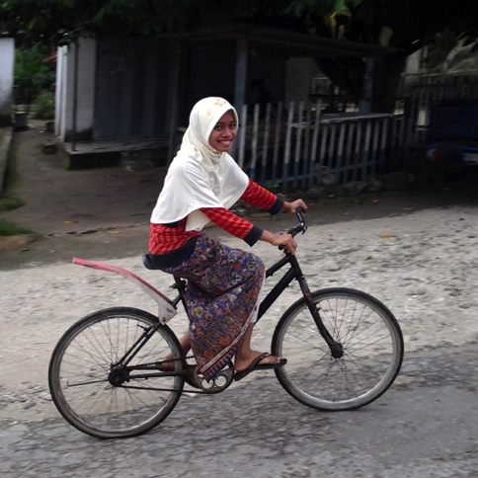
The future we want: our vision
Well-governed fisheries sector
Abundant fisheries resources
Healthy environment and habitats
Increased jobs, profits, and improved economy
Improved human health and prosperity
Notes:
The vision.
These are examples of Key words and phrases that can be used to develop a vision statement. Based on these key words a vision statement could be:
“A well-governed fishery sector that promotes a healthy ecosystem and sustainable use of the marine resources for the benefit of the key stakeholders.

Slide 9
What is the Ecosystem Approach?
EA is a holistic, integrated and participatory management approach that considers the major components in an ecosystem, and the social and economic benefits that can be derived through sustainable use.
CBD 2000 definition: It is a strategy for the integrated management of land, water and living resources that promotes conservation and sustainable use in an equitable way
Note: EA is often used interchangeably with ecosystem-based management (EBM)
9
Notes:
Based on their activity, discuss that existing fisheries management, due to its fisheries specific focus, is not capable of addressing many of the threats and issues facing the fisheries. The purpose is to illustrate that many of the threats and issues are not fisheries specific but broader to the wider ecosystem and that we need a broader approach.

Slide 10
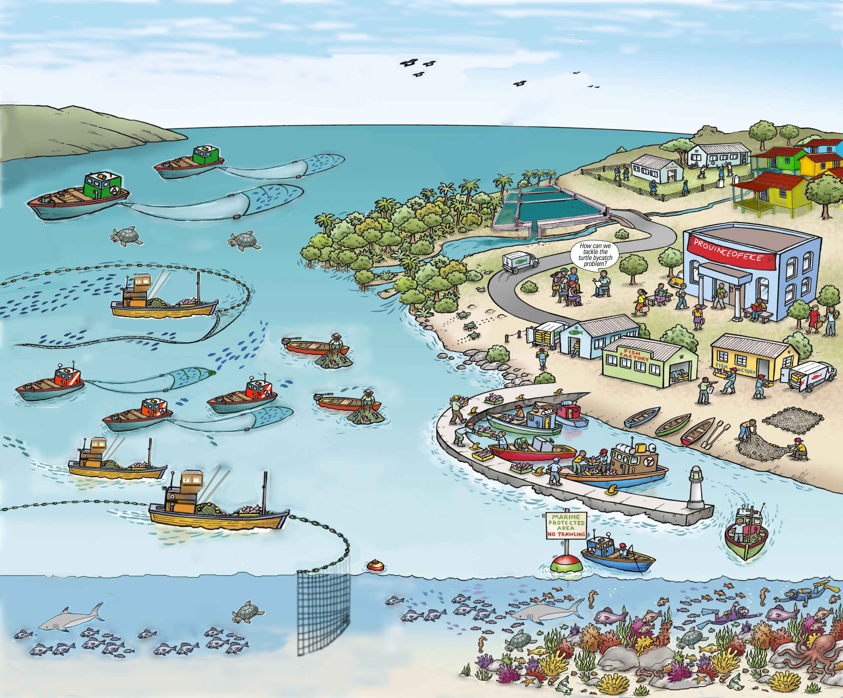
Fisheries a Ecosystems…
the bigger picture
Source: Adapted from FAO EAF Nansen Project
10
Notes:
Fisheries management is more than people in boats, fish in the sea. Need to get participants thinking and voicing the other elements that need to be included in fishery/ecosystem management ...(and so instil a need for EA). Get a few suggestions for this and build on it using subsequent slides. Refer to Nansen picture in visuals gallery (if you have it on wall), which is similar to this picture).
Participants should see at least:
Boats & fishers (both large and small scale
Fishing communities
Fish
Turtles and other endangered species
Habitats (e.g. mangroves)
Other users of the coast (e.g. aquaculture)
Factories – pollutants
Cities with government agencies
Other elements that participants might find.

Slide 11
Ecosystem Linkages
Source: UNEP (2011)
Notes:
An important thing to understand is that many elements are interconnected. Something affecting one part of the system can also have flow-on effects on other parts. For example, Starting with decreased fisheries in the middle of the diagram, this results in declining human well-being (top of diagram) that causes increased habitat destruction (left of diagram) and increased sediment and loss of seagrass, thus resulting in decreased fisheries

Slide 12
Ecosystems in a fishery context
Fish depend upon their surrounding supporting ecosystem (water, habitats) to survive and thrive
Managing fisheries in isolation from what they affect and are affected by has proven to be relatively ineffective and unsustainable
12
Notes:
Fish depend upon their surrounding supporting ecosystem (water, habitats) to survive and thrive.
Managing fisheries in isolation from what they affect, and are affected by, has proven to be relatively ineffective and unsustainable.

Slide 13
What are the benefits?
Why an Ecosystem Approach?
Integrated approach that allows trade-offs when balancing human and ecological well-being
Allows adaptive management – leading to more effective planning
Increased stakeholder participation
Provides a way to consider large-scale, long-term issues (e.g. climate change)
13
Notes:
Benefits are of EA are further considered when considering EAFM, but good to introduce them here (slides 19+20). The main benefits are:
1. EA facilitates trade offs. This helps resolve inter-sectoral conflicts; enables consideration of diverse stakeholders’ priorities and allows better balancing of resource use objectives with conservation objectives.
2. EA also allows adaptive management = by learning from the outcomes of previously employed management.
3. Reiterate that EA allows for more inclusive and equitable fisheries and coastal marine resource planning and decision making. Increased stakeholder participation can result in:
more transparent planning
increased equity in the use of coastal resources
recognizes cultural and traditional values
protects the fishing sector from the impacts of other sectors and vice versa
promotes gender equality
Benefits continue onto next slide.

Slide 14
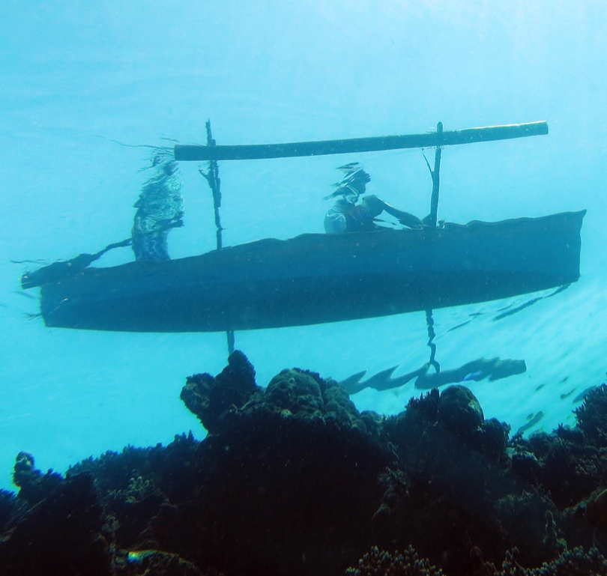
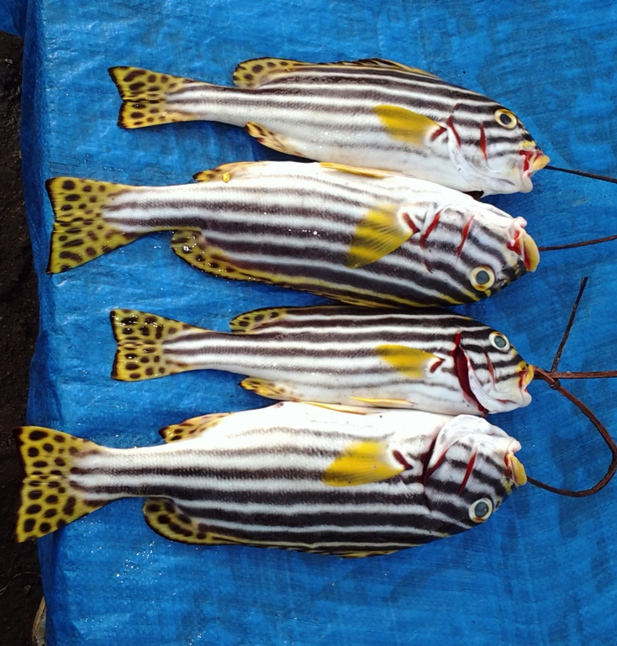
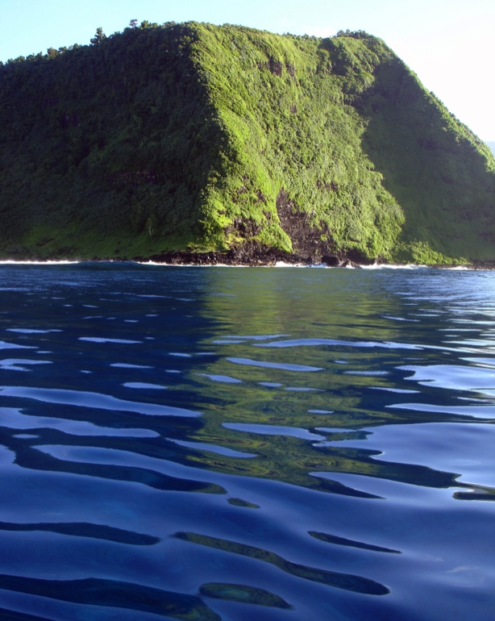
By maximizing ecosystem benefits, EAFM can result in increased food security & reduced poverty
Fish for food
Income
Employment
Livelihoods
Trade
Coastal protection
Notes:
EAFM aims to maximise ecosystem benefits that all lead towards increased food security and reduced poverty. These can be can be achieved directly through increased income, employment and improved livelihoods, as well as through increased foreign exchange and trade from fish and fishery products, providing that the increased foreign revenue trickle down to the poorer people.
Important to note that maximising ecosystem benefits through EAFM requires the balancing between multiple (or competing) objectives [e.g. Because fish are a finite resources, increasing employment often competes with increasing fish for food].

Slide 15
Key messages
Threats and issues to sustainable fisheries are broad in scope
- a number fall outside existing fisheries management
- a new approach is needed
EA is about integrative management across land, water and living resources
EA is a way of implementing sustainable development that promotes:
  - balancing ecological well-being with human well-being through good governance
15
Notes:
The trainers should ask questions to double check whether the messages are successfully delivered or not.

